Slide 1
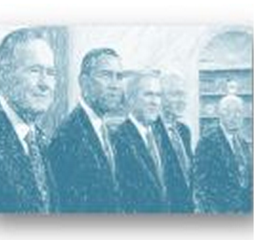
Presidential
Primary
Sources
Project
2012
https://k20.internet2.edu/presidents

Slide 2
PPSP Presentations
November 8 - Expansion of Global Democratization Following the Fall of the Berlin Wall by George Bush Presidential Library
November 13 – Cold War Crisis: Protecting Democracy in Berlin by Harry S. Truman Library
November 27 – Theodore Roosevelt and the Evolution of American Ideas by Theodore Roosevelt Center
Notes:
The project consists of presentations from 6 presidential libraries and national parks. Each of these providers has picked a topic that played a part in the development of global democracy, and have identified primary source documents associated with their topic.

Slide 3
PPSP Presentations
December 5 – Reflecting the Past, Sculpting the Future: The Evolution of Democracy in America by Mount Rushmore
December 6 – Washington’s Leadership in the International Community of the 18th Century – Valley Forge National Park
December 11 – The Camp David Accords: Exploring a Path to Peace by Jimmy Carter National Historic Site

Slide 4
Presidential
Primary
Sources
Project
2012
brought to
you by:
Notes:
Collaborative program sponsored by 3 big groups; U.S. Presidential Libraries and Museums, National Parks and the Internet2 K20 Initiative. The goal of the project is to engage classrooms throughout the national and international education community with an overarching theme of democracy, utilizing primary source documents for student research and presentation.

Slide 5
Cold War Crisis: Protecting Democracy in Berlin
Dr. Mark Adams, Director of Education

Slide 6
Cold War Crisis: Protecting Democracy in Berlin
Tweet Your Questions – hashtag# ppsp2012

