Slide 1
The authN and authR infrastructure of perfSONAR MDM
Ann Arbor, MI, September 2008

Slide 2
Outline
What is MDM perfSONAR?
Which problem has been solved?
The AAI of perfSONAR
Conclusion and future work

Slide 3
What is MDM perfSONAR?
perfSONAR (Performance focused Service Oriented Network Monitoring Architecture) system
Is a joint effort of EU-funded IST project GN2-JRA1, Internet2, ESnet and RNP
Open source development also for other interested networks
Name reflects the choice of Service Oriented Architecture
The solution is deployed and further elaborated in
European Research Backbone GÉANT
Connected European National Research and Education Networks
Internet2’ s Abilene network
ESnet (Energy Sciences network in US)
RNP (Brazilian NREN)

Slide 4
What is MDM perfSONAR? Partners
Connect. Communicate. Collaborate

Slide 5
What is MDM perfSONAR? Overview
The project is divided in two parts
The web services architecture
Java & Perl
Protocols
Based on the Open Grid Forum Network Measurement Working Group Schemas
It provides
Performance measurements in a multi-domain environment
Cross-domain monitoring capability

Slide 6
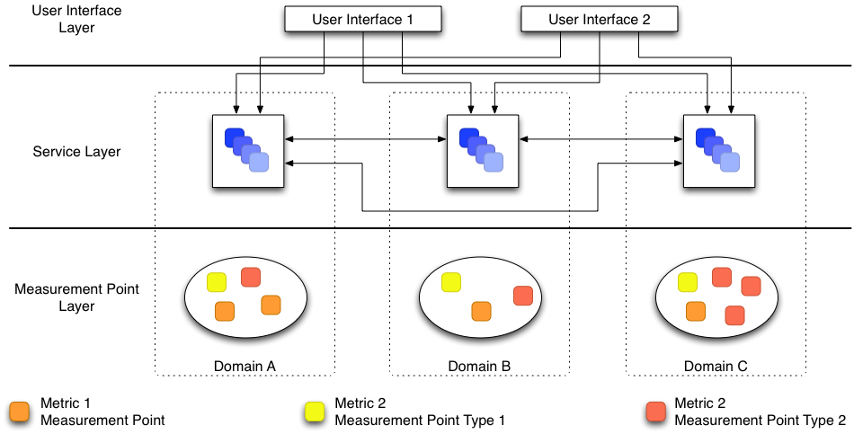
What is MDM perfSONAR? Framework
Connect. Communicate. Collaborate

Slide 7
What is MDM perfSONAR? Services in perfSONAR MDM 3.0
Available services in perfSONAR MDM 3.0
Lookup Service
Authentication Service
Measurement Archive Service
RRD and SQL versions
Measurement Point
SSH/Telnet
BWCTL
Command Line
TC

Slide 8
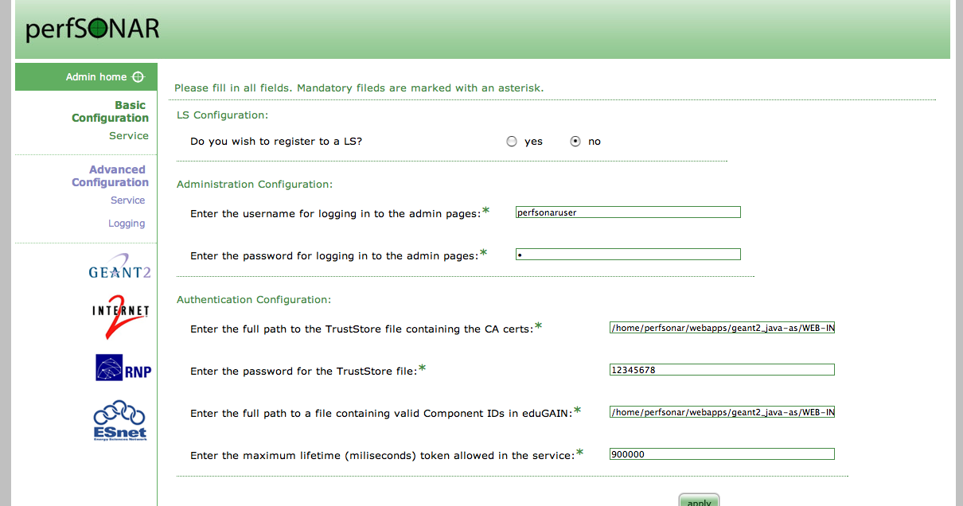
What is MDM perfSONAR? Services in perfSONAR MDM 3.0
Web admin interface!

Slide 9
What is MDM perfSONAR? Services in perfSONAR MDM 3.0
Easy distribution
WAR files
RPM & DEB packages
Also for Tomcat and eXist DB

Slide 10
Outline
What is MDM perfSONAR?
Which problem has been solved?
The AAI of perfSONAR
Conclusion and future work

Slide 11
Which problem has been solved?
User groups using perfSONAR
NOC (Network Operations Center) / PERT (Performance Emergency Response Team) staff
Project members (e.g. EGEE project)
End users
Administrative/non-technical staff
Users accessing perfSONAR services in a multi-domain environment

Slide 12
Which problem has been solved?
PerfSONAR services have to be protected
Accepting messages only from allowed users/user groups
Providing them only the data they need to get
The scenario we had found…
Different languages for web services
Different languages for visualization tools
Different AAIs in each domain
Not only the common web-based single sign-on solution

Slide 13
Outline
What is MDM perfSONAR?
Which problem has been solved?
The AAI of perfSONAR
Conclusion and future work

Slide 14
The AAI of perfSONAR MDM
The Authentication and authorization Service (AS)
Developed as another perfSONAR service
It is used by other services for
Checking whether the user is authenticated
Checking whether the user is allowed to do an action in a service
Checking user’s attributes
http://wiki.perfsonar.net/jra1-wiki/index.php/Authentication_Service_resources

Slide 15
The AAI of perfSONAR MDM
Connect. Communicate. Collaborate

Slide 16
The AAI of perfSONAR MDM
What does eduGAIN offer perfSONAR?
An unified framework of digital identity
URN registry service
PKI service
Neutral area of identity providers and messages
Shibboleth, PAPI, FEIDE, A-Select, …
MetaData Service
GÉANT Identity Provider (GIdP) for “homeless”
Java-based libraries for interacting with eduGAIN components
Support for our problems! :-)
What does NOT eduGAIN offer perfSONAR?
An Authentication and Authorization Service

Slide 17
The AAI of perfSONAR MDM: profiles
Transmission of credentials
Clients send security tokens representing themselves
Web Service Security (WS-SEC) standard
Different clients - different profiles
Automated Client (AC) profile: without human interaction Scripts
Client in a Web containEr (WE) profile: web-based applications
User behind a Client (UbC) profile: non web-based applications

Slide 18
The AAI of perfSONAR MDM: AC profile
Connect. Communicate. Collaborate
Unique and non-transferable ID for each client
URN obtained from eduGAIN registry service
Private and public key valid in the eduGAIN trust model
Subject Alternative Name of the cert contains the URN
Obtained from eduGAIN PKI
Security Token is based on the X.509 certificate

Slide 19
The AAI of perfSONAR MDM: AC profile
Connect. Communicate. Collaborate
Authentication data included in the SOAP header
Certificate of the client sent following the X.509 profile of WS-SEC
Generation of the ws-sec element is a proof of the authenticity of the client
Certificate contains the component ID
It is used for the Subject in the Attribute Request

Slide 20
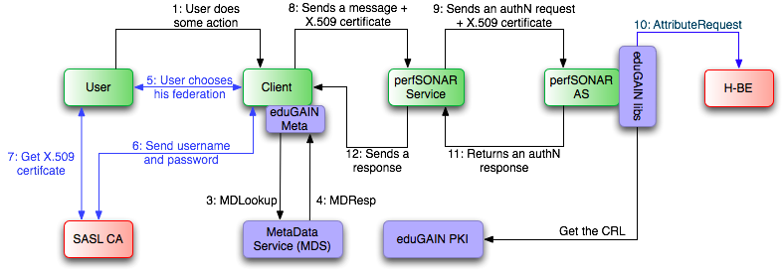
The AAI of perfSONAR MDM: UbC profile
Connect. Communicate. Collaborate
A similar case than AC
An online CA for getting the certficate
SASL CA

Slide 21
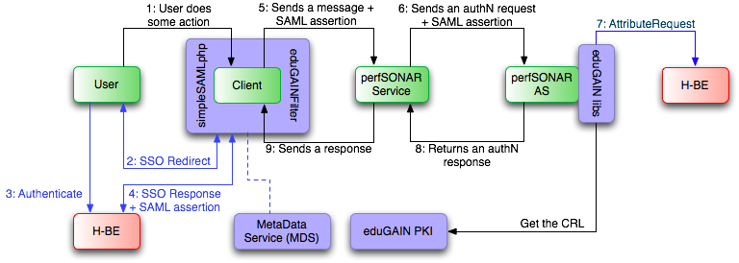
The AAI of perfSONAR MDM: WE profile
Connect. Communicate. Collaborate
Uses the eduGAIN webSSO profile
SAML assertions contain user’s credentials
Clients must have a pair of keys valid in the eduGAIN trust model
Security Token is based on SAML assertions

Slide 22
The AAI of perfSONAR MDM: WE profile
Connect. Communicate. Collaborate
Constraints of the relayed-trust SAML assertion
It must be bound to the client by the H-BE
User’s credentials legally obtained
It must be bound to the resource by the client
Malicious resource cannot re-use it
This SAML assertion contains
AudienceRestrictionCondition element with the component ID of the resource
Authentication statement
ConfirmationMethod element containing the value relayed-trust
SubjectConfirmationData has the SAML assertion got from the H-BE

Slide 23
The AAI of perfSONAR MDM: WE profile
Connect. Communicate. Collaborate
Authentication data included in the SOAP header
Relayed-trust SAML assertion sent following the X.509 and SAML profiles of WS-SEC
Certificate contains the component ID of the client
Subject of the SAML assertion used for requesting its attributes

Slide 24
The AAI of perfSONAR MDM: the future
Connect. Communicate. Collaborate

Slide 25
Outline
What is MDM perfSONAR?
Which problem has been solved?
The AAI of perfSONAR
Conclusion and future work

Slide 26
Conclusion and future work
perfSONAR has a full AAI with “minimal” efforts
Components for services
Libraries for services and clients
They don’t have to understand AA issues…
… or almost O:-)
UbC profile has to be redesigned
It uses SASL CA
Bad choice
There is a solution on the way
“eduroam style”
We are working on the authorization part
Making easy what it isn’t easy
Main goal for the future: the performance

Slide 27
Thank you for your attention!
Any questions?

