Slide 1
UW System Network
Volumetric DoS
Operational Efforts
2015/11/17
Michael Hare
UW System Network
https://stats.uwsys.net/
[yes, the website is self-signed]

Slide 2
Who am I?
Employed by the University of Wisconsin - Madison since 2000
My perspective: engineering, programming and operations
  Layer 2/3 WAN, monitoring + stats, DNS/DHCP
  No experience with IDS/IPS or firewalls other than iptables
Spent 13 years on the WiscNet project, now focused on the University of Wisconsin System Network [UWSYS.NET], servicing:
  13 universities, 13 two year colleges, UW–Extension
  ~180k students, ~40k faculty/staff
  Centrally managed network [Infinera/Juniper, 1G to 100G]

Slide 3
Presentation focus: How we mitigate volumetric DoS attacks
Our experience mitigating DoS attacks with a high degree of confidence based on IP header information.
Motivation
  Congestion: Typically last mile and paid transit.
  Customer state exhaustion: always inline firewalls/ips.
  Sleep: The internet doesn’t sleep, but I do. 66% of our detected DoS occurred outside Monday-Friday 0800 to 1700.
Disclaimer: I do not claim to be an expert or authority. I am not denying the existence of non volumetric attacks, but am leaving it out of scope.

Slide 4
Our high level volumetric DoS observations
Since 2015/04/07, we have logged 22 outbound, 36 inbound confirmed volumetric DoS attacks. A brief look at inbound events:
  ~ DNS, 44%. NTP, 32%. SSDP, 16%. Chargen, 8%.
  Max Rate 14.7Gbps. 11% > 10Gbps. 22% > 5Gbps.
  Longest Attack: 44 Minutes. 97% less than 30 minutes. 66% less than 10 minutes.
  66% occurred outside Monday-Friday 0800 to 1700.
  % of attacks during semester recess: 6%. Incidents are overwhelmingly related to residential networks.
  47% mitigated by filtering, 8% blocked by BGP blackhole.
  Service affecting: 11% (4) [entire campus]
    % that would have been service affecting without current mitigation in place: 19% (7)

Slide 5
Monitoring: data collection
SNMP [ifTable, CPU], ICMP monitoring and collection.
Screen scraping/XML where SNMP fails us or is too burdensome.
  CoS/QoS, ACL, DOM, BGP RIB
IPFIX v4/v6 flow export [1:256 sampling] anycasted with samplicator to nfcapd.
  NFDUMP/NFSEN + home grown software in use for analysis and RRD storage.
  On-net vs off-net, v4 vs v6, commodity vs research vs peering, protocol, subnet and port, AS Statistics [but CDNs limit the usefulness]

Slide 6
Juniper Firewall Filters
Per-interface statistics enabled.
Juniper policers limited to bps, no pps.
IPFIX flows can provide some of the same info as counters, but not all
  Flows fail at packet size, CoS, TCP flag counters
  Firewall counters work on family MPLS, CCC, bridge, etc
  Firewall counters infinitely more useful for defending the network control plane
If I can’t match it with a Juniper filter, I can’t police/redirect it anyway

Slide 7
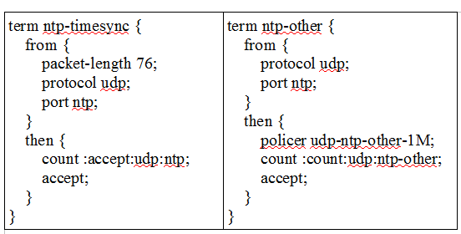
Juniper Firewall Filters example:

Slide 8
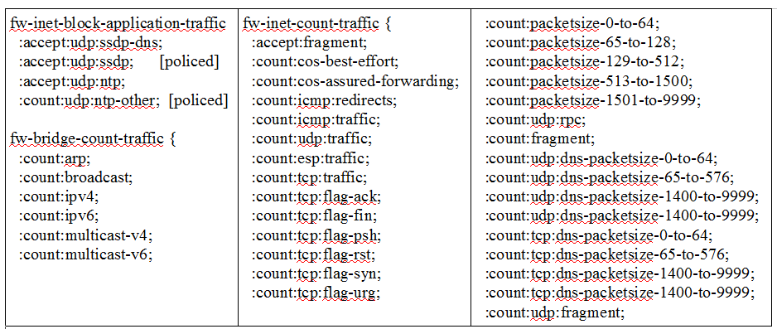
A crazy amount of counters: forwarding plane

Slide 9
What do we do with all of this data?
Process + technology
Tech:
  Reporting and thresholding of RRD datapoints integrated into monitoring system and other generated reports.
  RRD searching/graphing utilities.
  Lots of homegrown software.
Process:
  Alarm, syslog and report analysis provides feedback to changing/improving Juniper ddos-protection, firewall filters, etc.
  Significant events shared with UW System network campuses for feedback, discussion and direction.
  Drowning in data is not enough; you need to take action.

Slide 10
Customer tools
Tools
  Router proxy – deployed
  BGP Blackhole [RTBH] - deployed
  BGP FlowSpec - deployed
  Possible future directions: Centralized detection vs delegated web front ends
    Centralization has coordination issues with desired thresholds, whitelists [NAT, servers]
Methods
  Flows: cheap, but not so fast due to flow timeout limits (and other caveats)
  Capture: expensive, but fast
    Port mirror: burns useful forwarding ports but eases burden on collecting host by filtering
    Optical tap: increased processing requirement on collecting host

Slide 11
Customer tools
BGP blackhole [Remote Trigger Black Hole]
The Good
  v4/v6, highly scalable
  Internal RTBH communities translated to supported upstreams.
  Optional BGP community to trigger RTBH upstream but not internally.
  Juniper discard interface instrumented with packet counters.
The Bad
  Collateral damage increases with NAT/CGNAT.
  Blames the victim; choose your thresholds carefully.
In progress: peering with the Unwanted Traffic Removal Service [UTRS]

Slide 12
Customer tools
BGP FlowSpec support
The Good
  Targeted remediation
The Bad
  For us, currently v4 only
  Upstream FlowSpec support essentially unsupported, although we are trialing it with trusted peers.
  More granular than RTBH but filtering comes at cost of forwarding capacity, so allowed scale is reduced. More work is need here to understand the effects

Slide 13
Customer tools
Details
We log BGP RIB updates with exaBGP, providing an audit trail.
Run customer facing FlowSpec and RTBH BGP sessions parallel to your forwarding sessions to eliminate collateral damage from NLRI prefix-limit violations.
FlowSpec [and other Juniper counters] are fetched at one minute granularity, with results presented in near real time.
I’ve used native Juniper filter counters instead of Flowspec for several reasons
  Stability: counters stay in place in event of FlowSpec BGP failure.
  Feature: native Juniper filters have more features.
  Forwarding capacity: Currently, FlowSpec rules are applied to all ingress IPv4 interfaces. Our typical ratio of trusted to untrusted subinterfaces is 3:1. Counters are programmatically applied only to untrusted interfaces.

Slide 14
DNS DoS: Problem statement
Volumetric UDP port 53 attacks make up the brunt of our current unmitigated attacks. They are generally port 53 UDP > 1400 bytes + UDP fragments, although we have seen some (less successful) attacks with DNS packets less than 576 bytes.
UW System wide, port 53 UDP > 1400 bytes is usually under 1Mbps.
Get off my lawn: Was EDNS0 UDP Message size was a mistake?
  TCP for DNS > 576 would have kept Pandora in the box.
  Latency and resource concerns?
    CDN’s have already figured out that reducing D in BDP increases performance.
    US-CERT TA15-240A: Resolvers should be close to clients anyway

Slide 15
DNS DoS: Our high confidence solution?
  US-CERT TA15-240A [Controlling Outbound DNS Access] + ?
    Use flows to understand fragment use and reveal probable local recursive DNS servers.
    Flow frequency and talking to ROOT are decent indicators of active recursive servers. Scanning can also help to confirm the dataset. Obvious limitations to multihomed users.
    Action: police or mark packets with high loss priority. Policing might be OK for port 53, marking is probably better for fragments.
    Future desire to investigate JunOS 14.2 “flexible filter matching” to match ANY DNS type, etc
    Whitelist well known cloud DNS IPs as they are unlikely to be used for amplification.

Slide 16
Scary Stuff
What happens when we get a DoS we can’t handle? [Can’t match based on IP headers]
Transit clogged: RTBH + BGP more specifics
  Example: if 10.1.2.3 is attacked and is normally announced out of 10.1.0.0/16, announce 10.1.2.0/24 ONLY to exactly one transit provider that supports RTBH. RTBH 10.1.2.3 to said provider, and the rest of the /24 flows our way. Peers and other transit providers are unaffected.
  More NAT = more collateral damage
Low bandwidth layer 7 style application DoS attacks.
  DPI/scrubbing and/or reverse proxy: we are not providing these services.

Slide 17
Very Scary Stuff
We are not an enterprise, so a majority of our clients are untrusted, unmanaged hosts [BYOD: student/faculty laptops/cells].
The BYOD device at some point is likely used on a network that isn’t perfectly protected, so your LAN is probably still in trouble even if you IPS every routed vlan, although some wireless controllers can mitigate this.
Assume/accept the network environment is always compromised and learn to operate inside this environment.

Slide 18
Ludicrously Scary Stuff
What happens when your DNS infrastructure becomes the target? Solution: redundant DNS SOA and NS at least two AS hops away.
What happens when your routed infrastructure becomes the target?
Solution: protecting the control plane
Other scenarios security solutions can’t prepare you for:
  Routing protocol hijacks, fiber sabotage, inside jobs, targeted Intellectual Property espionage [Have I been watching too many movies?]
The cost to defend is generally far greater than the cost to attack.

Slide 19
Using the cloud
Cloud scrubbing is expensive and takes time to initiate.
  Minimize use by minimizing need. Host hardened services in the cloud.
Harden your DNS:
  Options: Redundant database backend SOA; Infoblox, Bluecat vs managed DNS [Cloudfare, UltraDNS, AWS, EasyDNS].
  If you colo at another institution, be thoughtful of shared topology [fiber, providers] that are not fully understood. Increasing physical distance likely increases your chance of success.

Slide 20
Don’t forget network infrastructure:
Protecting the control plane
  In addition to SNMP/VTY ACLs, we also ACL NTP, Radius, DNS, routing [BFD, BGP, IGMP LDP, MSDP, OSPF, PIM, RSVP, VRRP] as tightly as possible.
  Routing and ARP, LACP, NDP, PVSTP packets are subject to compliance policers that sit between the forwarding engine and routing engine punt path. This Juniper feature is called “ddos-protection”. Goal is for the routing engine to service a DoS itself [or bridge loop].
  IOS XR has a similar [better and worse] feature called LPTS.

Slide 21
Juniper DDoS protection
Does NOT work on the forwarding path, only packets destined to be handled by the routing engine.
Classifies punt path packets into various categories. [ARP, BGP, etc]
Packet rate policer, burst, logging and detection [flow, IFL] tweakable per category.
Operational data is collected over XML every 5 minutes. We use this data to set parameters, detect policed packet events, etc.

Slide 22
Summary: Armchair Quarterback Hour
Instrument your network: Do not operate in the dark. You need a baseline to understand what is normal to understand when you have a problem.
Volumetric attacks are the most frequent threat and can usually be mitigated without expensive appliances. Our methods are effective and efficient because they are stateless.
Use traffic engineering to segregate trusted/untrusted clients to different last mile paths.
  Advertise more specifics with no-export, increasing odds of providing capacity for trusted clients during events.

Slide 23
Summary: Armchair Quarterback Hour: Overtime
Money spent on capacity is used to provide service.
  Money spent on stateful roadblocks [IPS, DPI, firewalls] can only be used to deny service.
Stateful roadblocks have purpose, but must be positioned wisely.
  Protect your Intellectual Property and restricted data; encryption, appliance and segregation. No untrusted devices, no wireless. Everything else is a calculable, insurable risk.
BYOD OOB is a thorn and a blessing.
  Take advantage of this secondary OOB network. Campus network outages no longer leave cell users in the dark.
Focus planning.

Slide 24
FIN
Concepts from this presentation were first presented at a UWSYS.NET all-techs in September 2015.
Credits to Dale Carder from whom ideas were borrowed.

