Slide 1
DDoS Monitoring/Mitigation
using fastnetmon and ExaBGP
(Dan Dargel/Michael Hare)
2015-11-17

Slide 2
Dan Dargel
University of Wisconsin-Platteville
  ~8900 students and ~1000 staff
Network Architect
  Design, Implementation, and Operation of campus networks including fiber and copper infrastructure
Employed fulltime at UW-Platteville since 1993

Slide 3
Denial of Service (DoS) Attacks
There are many forms of DoS attacks, too many to discuss here. Many different tools are needed to mitigate them.
We will discuss how we handle the most common form attack we have experienced
  Distributed DoS
  More specifically Amplified or
  Distributed Reflective DoS (DRDoS)
  Spoofed request traffic results in large unsolicited response traffic from legitimate hosts (primarily UDP)

Slide 4
DDoS Attack Growth we Experienced
First attacks were small and brief but were blocked by the firewall. They primarily went unnoticed and didn’t show on traffic graphs.
As attacks grew some started to briefly knock down the firewall. These were often misdiagnosed or attributed to other factors. Obtaining evidence of an attack and its nature was difficult.
As scale and duration increased, critical outages occurred and were identified, but there were not the means to quickly mitigate the attacks.
Later, suspicions were confirmed that the DRDoS (Distributed Reflective DoS) attacks were gamers trying to knock other gamers out of the game. No services were directly targeted, but infrastructure fell down causing outages.

Slide 5
DDoS Attacks
DDoS attacks have grown in scale and frequency
DRDoS has created many times larger attacks
  Tens to hundreds of thousands of hosts, Mpps, and Gbps
Although firewalls block packets, it can’t handle the flows/sec and starts to fall down.
WAN links may become saturated
--What in your infrastructure will fall down first?

Slide 6
Know/learn your limits
DoS attacks are about resource exhaustion
Know where your resource limits/bottlenecks are
  WAN bandwidth
  Firewall/IPS flows/sec, pps, bps
  Router/Switch specs
  DNS server queries/sec, cpu, bps
  Logging rates
Anything stateful or having a table may become exhausted

Slide 7
Firewall specs
Paloalto PA-5050 (Active/Passive HA)
  10Gb/s Firewall throughput
  5Gb/s Threat Protect throughput
    Normally < 2.6Gbps for UWPlatt
  2M max sessions
    Normally <150k for UWPlatt
  120k new sessions/sec
Log rate of inbound denys may be overwhelming
  (Consider not logging inbound traffic that is normally denied which is destined to user endpoints)
  But it may reduce your visibility of attacks

Slide 8
Monitor your network
Monitor your network to establish a normal baseline
Determine thresholds to detect abnormalities
  They may differ by time of day, or year, or device
Establish monitoring/alerts/logs to know when you are or were under attack and to determine the nature of the attack
Monitoring needs to be realtime and fine granularity.
Some interactive troubleshooting tools:
  iftop, dnstop, parse_fw_traffic w/report interval

Slide 9
Providers and Customers need to work together and communicate
Providers and customers need to communicate actionable information in near realtime.
Providers need to implement means to address attacks that customers can use/trigger/opt into.
Providers need to police inbound customer traffic for IP spoofing and potential attack traffic.
Customers need to police their networks for botted systems and address outbound attacks and address spoofing. Block spoofing with ACLs/URPF/Policies

Slide 10
A great resource, Read it!
http://bcop.nanog.org/index.php/DDoS-DoS-attack-BCOP
  Details what to do before/during/after an attack
  Lists some tools

Slide 11
Network Architechture
Incorporate potential for DDoS attack into network design and addressing
  Location and roles of DNS servers
  Hierarchy of firewalls and routers
  Segregation so that an attack on one area may not impact another
    Datacenters
    DNS servers
    Residence networks
    Academic networks
    Business office networks
    Retail/Operations networks

Slide 12
Ways to mitigate attacks
Cloud DDoS scrubbing services $$
  Route service thru vendor to scrub attack traffic and tunnel legit traffic to server
    Use for determined attacks. May need on retainer. Setup architecture in advance.
Soak up the attack $$$
  Increase the scale, size, bandwidth of service to handle all attack traffic
  Distribute service to many locations. Enlist aid of peers.
Use DDoS mitigation appliances $
  Doesn’t protect your WAN link bandwidth or ISP
Use network infrastructure tools (from ISP); very scalable
  BGP blackhole
  BGP flowspec
  ACLs/Rate limits
  Use for common but not coordinated and determined attacks
  Means accepting some collateral damage or objective of attack

Slide 13
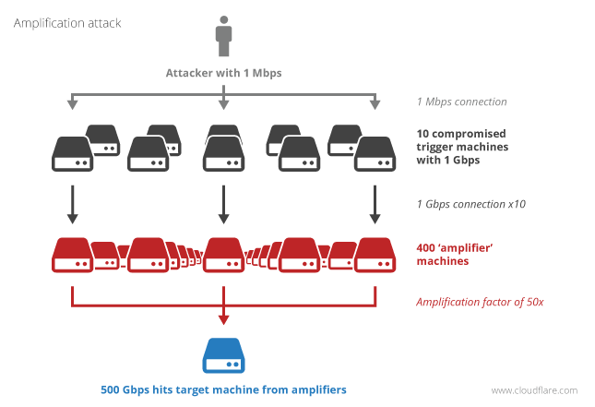
Distributed Reflective DoS (DRDoS)
Requests with source IP address of victim spoofed

Slide 14
Distributed Reflected DoS (DRDoS)
Protocol | Bandwidth Amplification Factor | Vulnerable Command | Protocol/Port
DNS | 28 to 54 | see: TA13-088A [4] | UDP/53
NTP | 556.9 | see: TA14-013A [5] | UDP/123
SNMPv2 | 6.3 | GetBulk request | UDP/161
NetBIOS | 3.8 | Name resolution | UDP/137
SSDP | 30.8 | SEARCH request | UDP/1900
CharGEN | 358.8 | Character generation request | UDP/19
QOTD | 140.3 | Quote request | UDP/17
BitTorrent | 3.8 | File search
Kad | 16.3 | Peer list exchange
Quake Network Protocol | 63.9 | Server info exchange
Steam Protocol | 5.5 | Server info exchange
Multicast DNS (mDNS) | 2 to 10 | Unicast query | UDP/5353
RIPv1 | 131.24 | Malformed request | UDP/520
Portmap (RPCbind) | 7 to 28 | Malformed request | UDP/111
Source: https://www.us-cert.gov/ncas/alerts/TA14-017A

Slide 15
Mitigation
ACLs/Policers on ISP routers
  SSDP
  Chargen
  NTP
  DNS?
  UDP fragments?
Attack detection and response
  BGP blackhole (RTBH, RealTime BlackHole)
  BGP flowspec

Slide 16
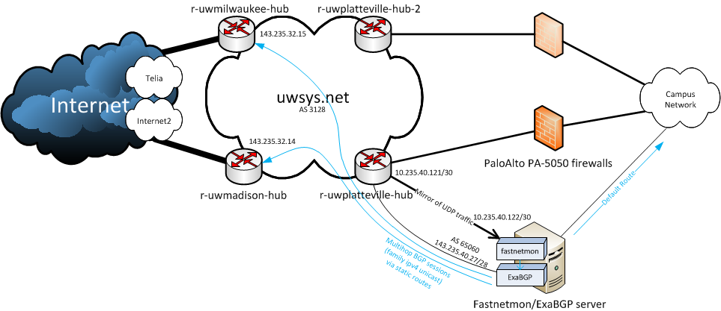
Fastnetmon/ExaBGP Architecture

Slide 17
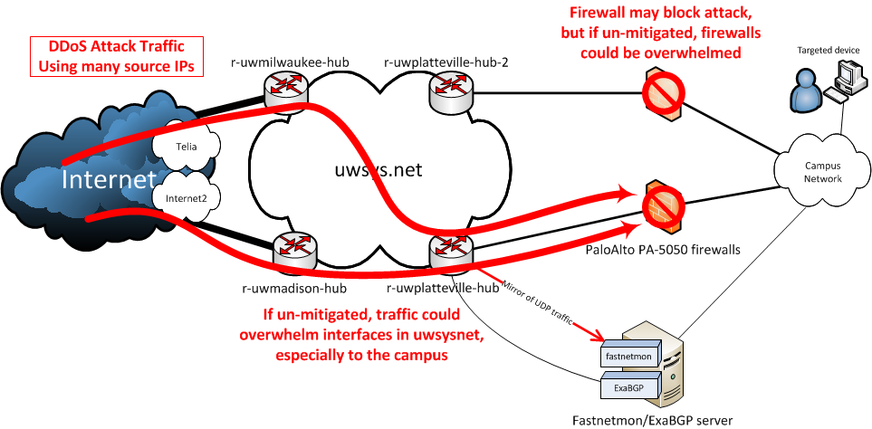
DDoS attack

Slide 18
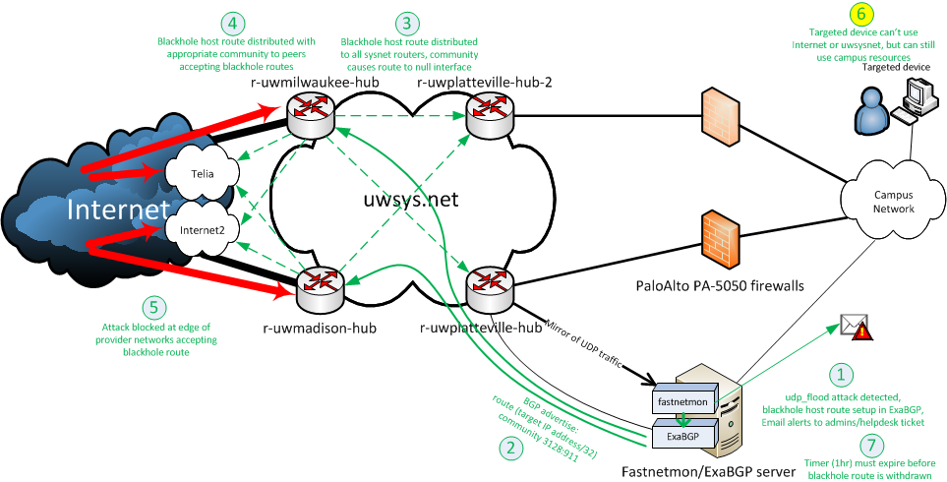
DDoS attack mitigation

Slide 19
fastnetmon
Supports many capture/flow methods
  NetFlow, IPFIX, sFLOW, SnabbSwitch, netmap, PF_RING, PCAP
Incoming and Outgoing traffic
  On same interface or two different mirrored interfaces
Triggers on per IP thresholds for packets/bytes/flows per second
Integration with ExaBGP for blackhole routes or flowspec for well know attacks
Detects a DDoS attack in a few seconds
Can support rates of up to 10Gbps and 12Mpps with certain hardware and netmap. Much more with flow based methods, but are slower to detect.
Provides flow summary and TCPdump like trace, can collect pcap dumps of attack traffic
Has had significant enhancements over the last 6 months

Slide 20
Fastnetmon
Supported attack detection
syn_flood
  TCP packets with enabled SYN flag
udp_flood
icmp_flood
ip_fragmentation_flood
  IP packets with MF flag set or with non zero fragment offset

Slide 21
/etc/fastnetmon.conf
enable_ban = on
ban_time = 3600
ban_for_pps = on
ban_for_bandwidth = on
ban_for_flows = on
threshold_pps = 40000
threshold_mbps = 500
threshold_flows = 2000
ban_details_records_count = 1000
redis_port = 6379
redis_host = 127.0.0.1
check_period = 1
sort_parameter = packets
max_ips_in_list = 9
notify_script_path = /usr/local/bin/notify_about_attack.sh
redis_enabled = no
interfaces = p2p1
netflow = off
netflow_port = 2055
netflow_host = 0.0.0.0
sflow = off
sflow_port = 6343
sflow_host = 0.0.0.0
mirror = on
mirror_netmap = off
pcap = off
average_calculation_time = 5
enable_connection_tracking = on
enable_pf_ring_zc_mode = off
process_incoming_traffic = on
process_outgoing_traffic = on

Slide 22
/etc/networks_list
137.104.0.0/16
/etc/networks_whitelist

Slide 23
fastnetmon_client

Slide 24
/var/log/fastnetmon_attacks/…

Slide 25
/var/log/fastnetmon_attacks/…

Slide 26
/var/log/fastnetmon.log

Slide 27
/etc/exabgp/exabgp.conf
# exabgp.conf
# Used to inject blackhole routes into uwsys.net within 137.104.0.0/16
#
# Blackhole Communities:
# uwsysnet_blackhole 3128:911 blackhole this route in AS3128 and upstreams
# uwsysnet_blackhole_internet 3128:912 blackhole this route in upstreams but NOT AS3128#
# Well-Known Communities:
# no-export 65535:65281 do not advertise to any eBGP peers
# no-advertise 65535:65282 do not advertise to any BGP peer
# local-as 65535:65283 do no advertise this route to peers outside the local as
group sysnet_blackhole {
local-as 65060;
peer-as 3128;
router-id 143.235.40.27;
local-address 143.235.40.27;
hold-time 180;
graceful-restart 1200;
family {
ipv4 unicast;
}
static {
# route 10.10.10.1/32 next-hop 192.0.2.1 community 3128:911;
# route 10.10.01.1/32 next-hop 192.0.2.1 community [ 3128:911 65535:65281 ];
# The next line is used to indicate where to automatically add routes at, do not edit it!
# INSERT_NEW
# 2015-09-04 21:46:31 - auto-blachole incoming
route 137.104.212.131/32 next-hop 192.0.2.1 community [3128:911];
# 2015-07-08 03:07:18 - auto-blachole incoming
# 2015-07-08 04:16:18 - route 137.104.231.0/32 next-hop 192.0.2.1 community [3128:911];
}
neighbor 143.235.32.14 {
}
neighbor 143.235.32.15 {
}
}

Slide 28
False Positives
QUIC protocol (trips pps limit)
  Recommend to trigger on flows/sec and set high Mbps and pps thresholds
Whitelist DNS and other servers or just generate alerts only and use ExaBGP manually
Is the attack actually backscatter from an attack on someone else?

Slide 29
BGP flowspec
Create ACL like rules that can be advertised to upstream providers
Providers can implement filters in their core or at their edge to block/rate limit traffic
Rule action can potentially be:
  Accept
  Discard
  Rate-limit
  Redirect
  Redirect-next-hop
  Copy
  Mark
  Action sample|terminal|sample-terminal

Slide 30
/etc/fastnetmon.conf (flowspec)
# This options are mandatory for Flow Spec attack detector
collect_attack_pcap_dumps = on
process_pcap_attack_dumps_with_dpi = on
exabgp = on
exabgp_command_pipe = /var/run/exabgp.cmd
exabgp_community = 65001:666
exabgp_next_hop = 10.0.3.114
exabgp_flow_spec_announces = on
# Please switch off unicast BGP announces with ExaBGP because they are not compatible with Flow Spec
exabgp_announce_whole_subnet = no
exabgp_announce_host = no
Currently supports only most popular amplification attack types
  DNS amplification (drop all udp traffic originating from 53 port)
  NTP amplification (drop all udp traffic originating from 123 port)
  SSDP amplification (drop all udp traffic originating from 1900 port)
  SNMP amplification (drop all udp traffic originating from 161 port)

Slide 31
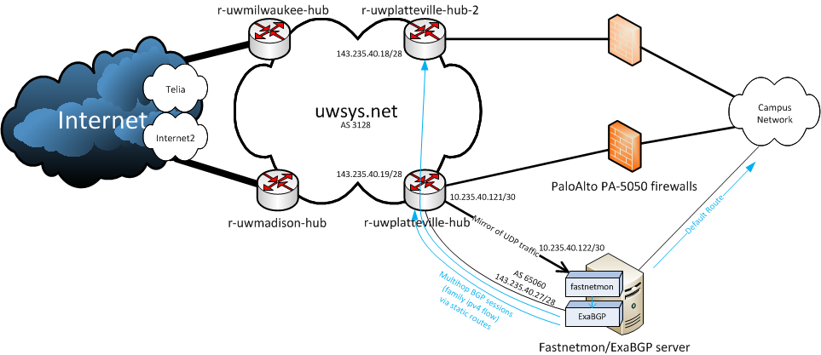
Fastnetmon/ExaBGP Architecture (flowspec)

Slide 32
/etc/exabgp/exabgp.conf (flowspec)
# flowspec syntax:
# flow {
# route give-me-a-name
# route-distinguisher|rd 255.255.255.255:65535|65535:65536|65536:65535; (optional)
# next-hop 1.2.3.4; (to use with redirect-to-nexthop)
# match {
# source 10.0.0.0/24;
# source ::1/128/0;
# destination 10.0.1.0/24;
# port 25;
# source-port >1024
# destination-port =80 =3128 >8080&<8088;
# protocol [ udp tcp ]; (ipv4 only)
# next-header [ udp tcp ]; (ipv6 only)
# fragment [ not-a-fragment dont-fragment is-fragment first-fragment last-fragment ]; (ipv4 only)
# packet-length >200&<300 >400&<500;
# flow-label >100&<2000; (ipv6 only)
# }
# then {
# accept;
# discard;
# rate-limit 9600;
# redirect 30740:12345;
# redirect 1.2.3.4:5678;
# redirect 1.2.3.4;
# redirect-next-hop;
# copy 1.2.3.4;
# mark 123;
# action sample|terminal|sample-terminal;
# }
# }
# }
#
# one or more match term, one action
# fragment code is totally untested

Slide 33
/etc/exabgp/exabgp.conf (flowspec)
group sysnet_flowspec {
local-as 65060;
peer-as 3128;
router-id 143.235.40.27;
local-address 143.235.40.27;
hold-time 180;
graceful-restart 1200;
family {
ipv4 flow;
}
flow {
route {
match {
source 205.213.14.55/32;
destination 137.104.167.144/32;
source-port =443;
protocol tcp;
}
then {
discard;
}
}
}
neighbor 143.235.40.19 {
}
neighbor 143.235.40.18 {
}
}

Slide 34
Non-initial fragments
Much of the attack traffic may be fragmented packets
Non-initial fragments may be 2/3 to 3/4 of the traffic.
SRC/DST ports of non-initial fragments can’t be identified in a stateless manner, making ACLs and flowspec rules difficult, but rate limits and QoS may help

Slide 35
DNS infrastructure
Separate Authoritative vs Recursive resolver DNS servers
Mix of offsite and onsite authoritative DNS servers
  Be prepared to isolate them
  Don’t allow inbound access to all of your onsite DNS servers
Require clients to use your onsite recursive resolvers (US-CERT TA15-240A)
Use servers that are hardened and have mitigation features

Slide 36
Resources
DDoS Mitigation
  http://bcop.nanog.org/index.php/DDoS-DoS-attack-BCOP
BGP Blackhole (RTBH) and flowspec
  http://www.cisco.com/web/about/security/intelligence/blackhole.pdf
  https://kb.wisc.edu/uwsysnet/search.php?q=blackhole&cat=0
  https://www.nanog.org/sites/default/files/wed.general.trafficdiversion.serodio.10.pdf
Fastnetmon:
  https://ripe71.ripe.net/wp-content/uploads/presentations/17-RIPE71_new_slides.pdf
  https://github.com/pavel-odintsov/fastnetmon
  https://github.com/pavel-odintsov/fastnetmon/blob/master/docs/EXABGP_INTEGRATION.md
  https://github.com/pavel-odintsov/fastnetmon/blob/master/docs/BGP_FLOW_SPEC.md
ExaBGP
  https://github.com/Exa-Networks/exabgp
  https://www.m00nie.com/?s=exabgp
DNS
  https://www.us-cert.gov/ncas/alerts/TA14-017A
Firewall on Demand
  https://www.terena.org/activities/tf-noc/meeting5/slides/20120216-firewall.pdf
  http://www.terena.org/activities/tf-msp/meetings/20141127/slides/Yannis.pptx

Slide 37
/usr/local/bin/notify_about_attack.sh
#!/usr/bin/env bash
# Blackhole and IP address and notify the NOC
# $1 client_ip_as_string
# $2 data_direction
# $3 pps_as_string
# $4 action (ban or unban)
email_notify=“noc@somewhere.edu"
if [ "$4" = "unban" ]; then
# Unban actions if used
/usr/local/sbin/auto-blackhole remove:$1
exit 0
fi
if [ "$4" = "ban" ]; then
cat | mail -s "FastNetMon Guard: IP $1 $2 attack with power $3 pps" $email_notify;
# You can add ban code here!
exit 0
fi
if [ "$4" == "attack_details" ]; then
cat | mail -s "FastNetMon Guard: IP $1 $2 attack with power $3 pps" $email_notify;
/usr/local/sbin/auto-blackhole $1 $2
exit 0
fi

Slide 38
/usr/local/sbin/auto-blackhole

Slide 39
/usr/local/sbin/blackhole

Slide 40
/usr/local/sbin/exabgp_reload

Slide 41
Paloalto syslog: parse_fw_traffic

