Slide 1
Safe or Performant?
We want both!
Claudio Allocchio
Internet2 Tech Exchaange
New Orleans, 11 Dec 2019

Slide 2
Which Network do we want to have?

Slide 3
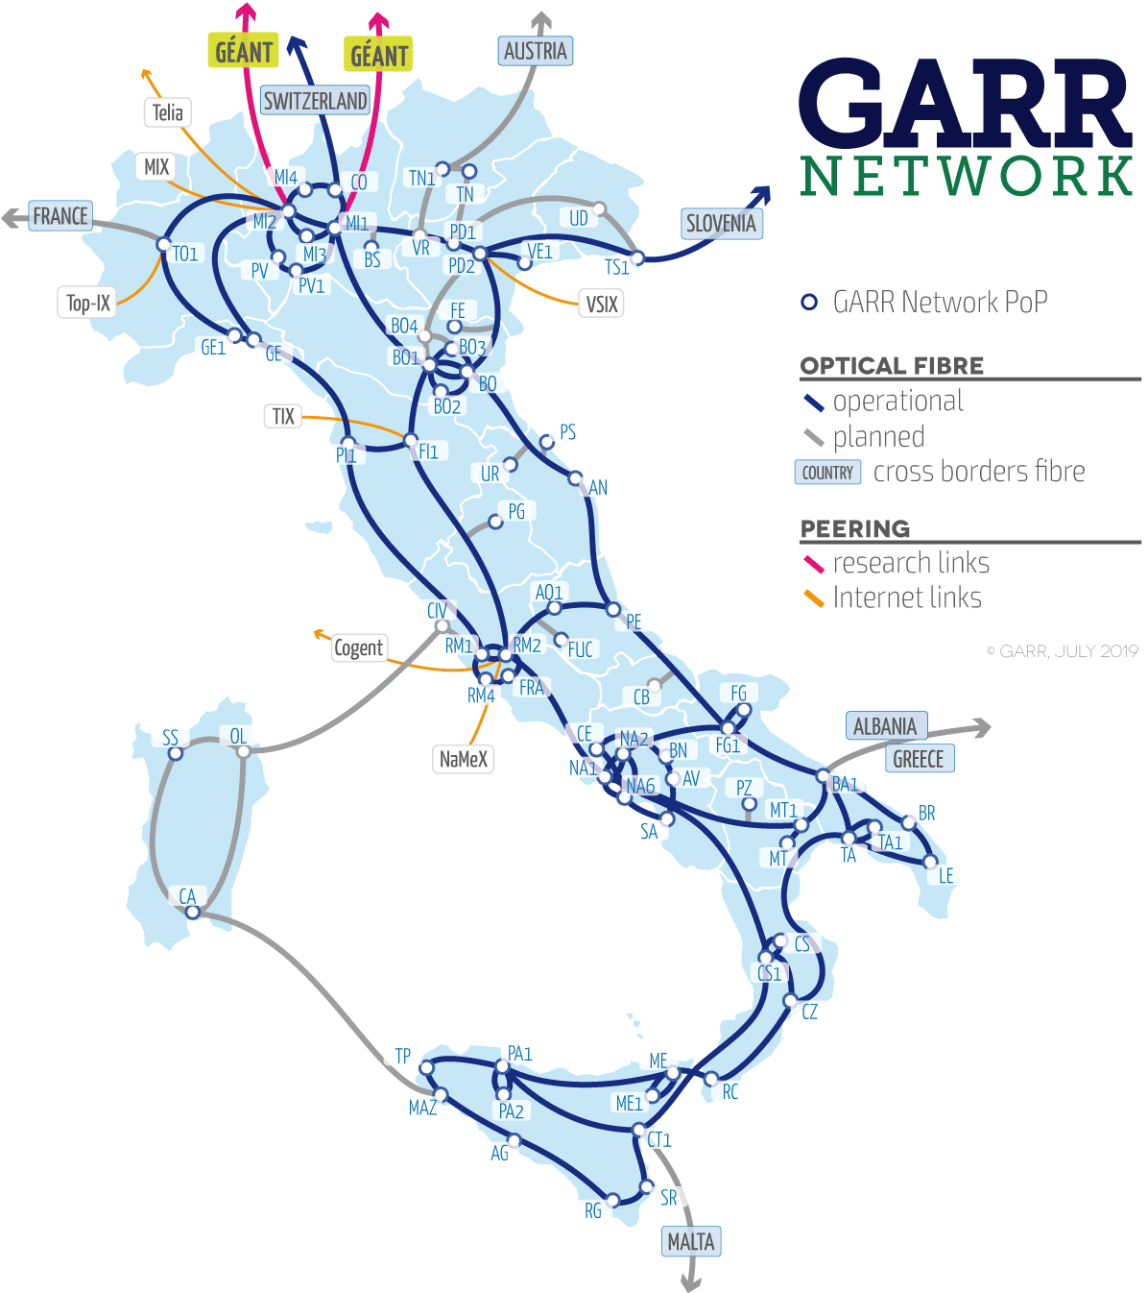
More that 16.000 km of GARR owned fibers
More than 1000 user sites interconnected
Fiber connection to 98% of user sites
> 1,8 Tbps aggregated access capacity
> 3,5 Tbps total backbone capacity
2x200 Gbps IP capacity to GÉANT
Cross border fibers with ARNES (Slovenia), SWITCH (Switzerland).
> 100 Gbps to General Internet and Internet Exchanges in Italy
NOC and engineering are in-house, in Rome.
Interconnects Data Centres of:
INFN
HTC - 1 Tier1 (CNAF-Bologna) + 9 Tier2 (Bari, Catania, Frascati, Legnaro, Milano, Napoli, Pisa, Roma, Torino)
ENEA
HTC & HPC - Portici (NA), Brindisi
CINECA
HPC - Marconi (Bologna)
GARR
Bari, Catania, Cosenza, Napoli, Palermo
CRS4
Cagliari
RECAS
Bari, Catania, Cosenza, Napoli
CNR
Roma, Pisa

Slide 4
Research and Education Networks are…
Very High Bandwidth (we are close to Terabit/sec links)
Very Low Error Rate
Very Low Bandwidth
Overprovisioned
Open and Neutral
Symmetrical
Offer a Rich Services Portfolio
Offer a very safe network service
So… WE ARE SAFE AND PERFORMANT!
The “paradise” for users, is it?

Slide 5
So why we still hear these comments?
This application does not work!
I cannot connect there!
My file transfer is taking ages!
eduroam and WiFi here are terrible!
My 4G mobile connection is much better than my net in the office!
I got my PC infected by a virus…
The Network is SLOW !

Slide 6
But where are the users connected?
On their campus Local Area Network
On the guest campus which they are visiting
NRENs present and advertise services to “their” users as if they are on the backbone…
But THEY ARE NOT!
They are on Local Area Networks, connected to the backbone.

Slide 7
But Campuses LANs are not so bad!
Fast internal fiber connections
Fast network devices
Fully controlled Wireless LAN Services
Efficient ICT and Network Security services
Fast and Powerful PCs and workstations
Efficient access to the network

Slide 8
What often happens at the edge?

Slide 9
Easy to get out, to reach Paradise!

Slide 10
Not so easy to get in…

Slide 11
We defend Campuses LAN to protect dumb users…

Slide 12
Many efficient ”border protection” solutions!

Slide 13
Which works very well even with very large traffic

Slide 14
But we are NRENs, and users do different activities…

Slide 15
Some applications are demanding and unusual
LoLa
  High Packets per Second rate (1K UDP packets)
  Very sensitive to jitter and errors
Ultragrid
  High bandwidth
  Sensitive to jitter and errors
MVTP
  Usually 10G connection
  Very sensitive to errors
Nimbra
  Very high bandwidth or
  Very sensitive to errors
…

Slide 16
(Real) stories from the users’ community (1)
IT department does not inform the Arts department of an important network reconfiguration; users struggle for days calling IT people but nobody really take care to dig and understand the problem.
  “Arts users just send email, do social networks and browse”
IT department sticks (correctly) to its security policies, but does not give details to users about which are the effects on their “non usual” applications; users spend many effort to understand why the application does not work correctly, until an IT engineer from the other connected institutions call and is explained about the local setup
  “My users do not need to know about IT security, it is my business”
There is no exception to the single possible configuration for all departments. Requesting a “special handling” needs escalation to top management, even if it is just to enable a “ping” to a single address.
  ”One solition serves all! We decide top down which is the good one”

Slide 17
(Real) stories from the users’ community (2)
This application is not allowed on our campus network, you need to ask (and pay for) a dedicated LAN for your department.
  “Why shall we explore solutions and serve special needs? Let them out!”
IT department does not know how the users’ application deals with the network (even if it is well documented) and given users’ are not techies, why don’t they just use another which everybody uses?
  “Non techies are not trusted even if they present very technical documentation”
Network traffic routing affects latency (and jitter) but the backbone management cares only about bandwidts monitoring. Users try to explain the issue, but nobody is ready to take care of the problem, there is no “procedure”
  ”IT people still consider the network as a file transfer tool”

Slide 18
(Real) stories from the users’ community (3)
The traffic shaper or firewall is perfectly tuned to serve all possible traffic, so there is no reason to turn it off for a specific service/application. Users often can only say “it does not work”, but cannot really debate technically.
  “Again, one solution serves all and that’s it!”
IT is collaborative, and takes care of the users’ issue, but then discovers they cannot apply the solution because the Legal Office of the institutions needs to approve it.
  “Paper rules are higher than technical competence and work”
The IT department is centralized and outsourced, so any time users call they get a different people on the other end, and need to re-explain everything form the basics, and not every time the explanation reaches the goal
  ”The internet service is a commodity like the telephone, R&E is not special”

Slide 19
Is this R&E networking ?

Slide 20
Or this one?

Slide 21
Business or general purpouse solutions?
What is “inside” and where is “the wild world out there”?
If I “defend” from the wild world out there, do I make this happen again?

Slide 22
When the standard solution does not work…
Talk, collaborate, among different specialists,
Involve IT people in looking for the solution(s) since the beginning
Explain in detail what the “special service” does on the network
Create a special area where you run the service (not necessarily DMZ)
Make the “special service” machine an “appliance”
Make the policies friendly to non standard solutions

Slide 23
Talk, collaborate, among different specialists
Users give for granted they connect their application and magically goes trought until the other end(s) smoothly (because we IT people tell them about our wonderful backbones).
Of course users MUST test in advance, not the morning they need the service
IF IT DOES NOT WORK, let’s start the virtuous talking loop:
Local networking and security people shall be easy to reach and to talk to
IT people be prepared to understand (often “guess”) what users are talking about
Ask users about technical documentation about their “strange stuff” and in case check who are the experts to talk about the “strange stuff” (the IT people of the “strange stuff”)
Pool together and look for solutions maybe outside the default ones

Slide 24
Involve IT people in looking for the solution(s) since the beginning
Users are not people who wants to disrupt services and IT people are not policemen there to keep order.
Users shall involve IT people, and the IT people shall engage in the challenge
Because it will help to deliver the full power of services to those who needs them
Because it will save also “the others” from possible disruptions
Because it is a challenging activity, and to IT’S FUN !

Slide 25
Explain in detail what the “special service” does on the network
Unpack the “strange stuff” to see in details what’s inside the box, and what is does with the network.
Documentation is avaiable (if not… the “strange stuff” developers are guilty!)
Examine the effects on the LAN and “border” devices, and evaluate technically
Put your hands on the “strange stuff” and have a look (maybe even using sniffers to dump the traffic and have a deep inside look)

Slide 26
Create a special area where you run the service
So now you know the ”strange stuff”, and it does not fit well in standard solutions, what next?
Do you have a DMZ? Give it a try. If not…
Create a dedicated and isolated from the LAN connection from the “strange stuff” and the external backbone:
  A VLAN often works, unless performance in affected by the switches queueing systems
  Can you go down to layer1 and make a physical path?
  What about dedicating a port on the border device to connect this isolated area?
  In case, bypass defualt filtering/shaping/firewalling. You are not putting at risk the LAN, just this “speacial isolated area” in case.
  What about considering extending this VLAN to the backbone PoP, and have a PoP router as default gateway for the isolated area?
  do not ask users to pay for building this isolated area, bacause this is usually possible with existing resources.
If the isolated area goes on fire, all the rest is safe anyhow.

Slide 27
Make the “strange stuff” machine an “appliance”
Because the “strange stuff” usually has strong requirements also on the hosting workstation, then
Carefully help the users to tailor the workstation into a dedicated appliance.
  In case create a dedicated partition on the workstation to boot from when the “strange stuff” is in use (and do not install it on the standard partition)
  Remove all services and applications which are not needed (you will strongly reduce the chances to have a buggy service on board which can be used for an exploit)
  The “strange stuff” usually is not so widespread, so it is not an appealing application to find a bug in it and use it to attack or infect others.
  As an appliance, it will likely be the only worstation on the isolated area

Slide 28
Make the policies friendly to non standard solutions
So… we do have a technical way forward to deploy… but does it fit my local policies?
Go and check that your local policies, usually written by a lawyer or by somebody who thinks like a lawyer, allows to deploy flexible solutions.
Explain the policy makers why flexible solutions can work and be safe and performant too.
Explain this is the way to deliver safe and performant services at the level you pay for the backbone you have.
Explain the reasoning of being flexible: there is not “IN” and “OUT” in a worldwide community for research and education… your campus is just a little piece, not the world.
Explain that the gained value of having your users happily working with their colleagues is an unvauable asset to spend with funding bodies.

Slide 29
It’s a lot of sometimes controversial discussions…
So...
DISCUSSION and QUESTIONS!

Slide 30
Thank you

