Slide 1
COmanage working group
Internet2 Fall Member Meeting 2011

Slide 2
Agenda
Intellectual Property Rights Reminder
http://www.internet2.edu/membership/ip.html
Introductions
Major changes and updates
CO activity
International collaboration
Roadmap
Architecture
Technical enrollment
Latest in terminology

Slide 3
Roadmap
Demo/Proof of Concept Releases ------------------------------ 0.1 Demo service (completed March 2011) 0.2 Enhanced demo service (completed August 2011) 0.3 Basic Shape (due November 2011) 0.4 Shiny Basic Shape (due January 2012) Early Adopter Releases ---------------------- 0.5 Polished Basic Shape (due March 2012) – early adopter release 0.6 Enhanced Registry General Releases ---------------- 1.0 Release Candidate 1.1 Provisioning 1.2+ Various features TBD
Notes:
.3 Profile Management Documentation
CO-177 Enrollment Workflow v1
CO-99 GMS Integration
CO-188 Last Tuesday 5:51 PM Provisioning Exec API
CO-92 Last Tuesday 5:50 PM Make self-editable fields configurable
CO-184 Last Tuesday 5:50 PM Enrollment Workflow User Interface: Manage My Identity

Slide 4
Enrollment
What the team is coding against
https://spaces.internet2.edu/display/COmanage/Registry+Enrollment

Slide 5
Terminology
Glossary
https://spaces.internet2.edu/display/COmanage/Glossary
Terms of particular interest
CO versus COU
Home Institution Identity versus Organizational Identity

Slide 6
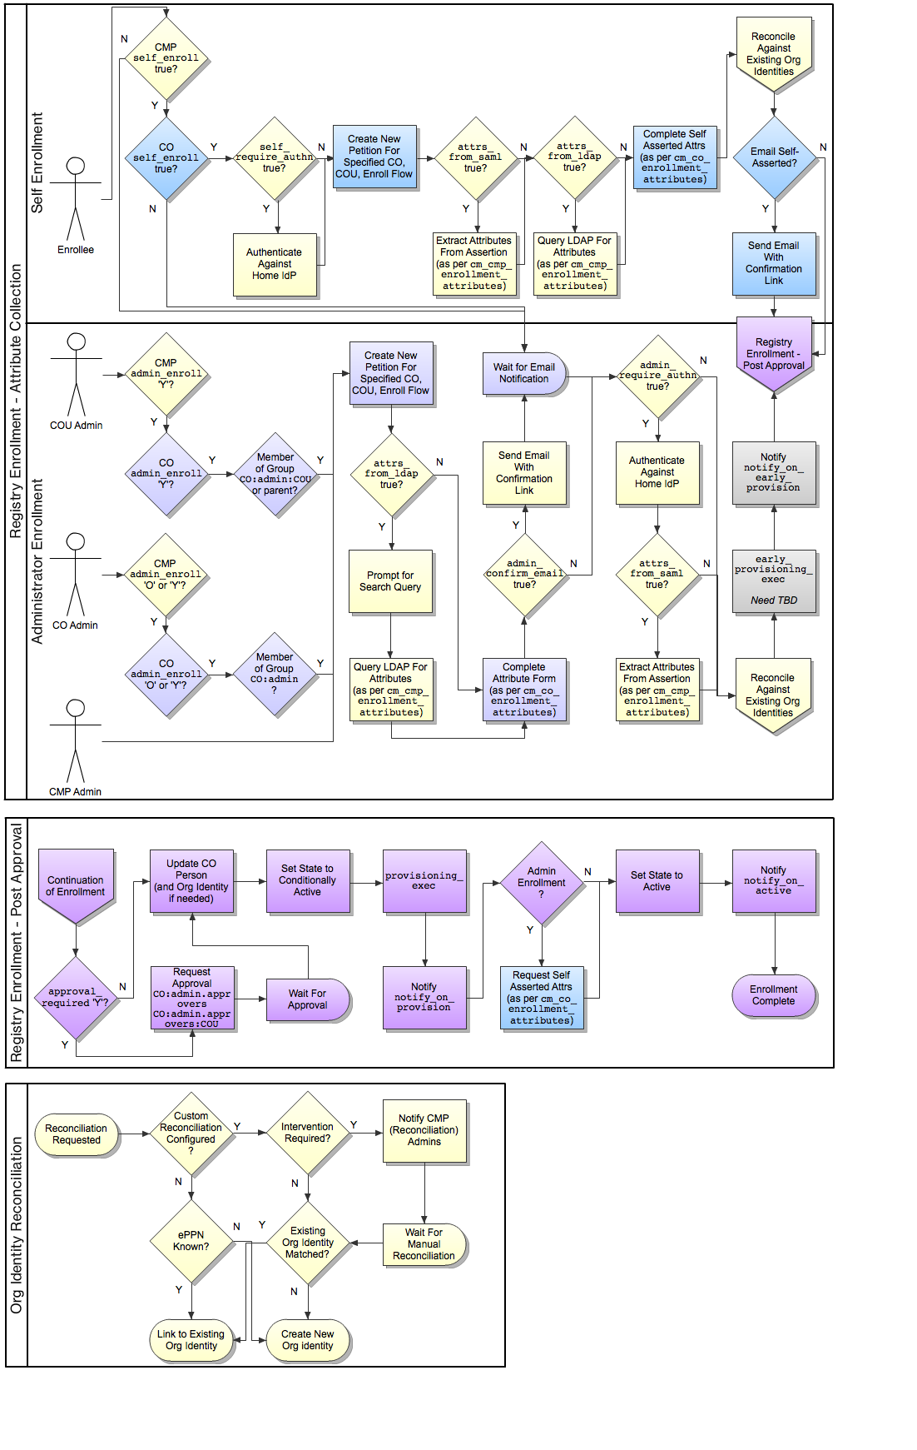
Comanage Reference Architecture

Slide 7
More information
https://spaces.internet2.edu/display/COmanage/Home
http://www.internet2.edu/comanage/
Mailing list: comanage-community@internet2.edu

