Slide 1
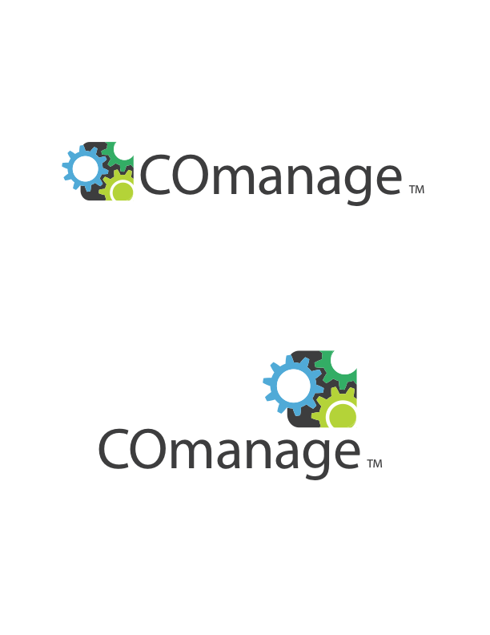

Slide 2
… enables Collaboration by providing:
a framework for collaboration applications that can use identity services
A prepackaged appliance for small organizations with simple needs

Slide 3
… enables Collaboration by providing:
a framework for collaboration applications that can use identity services
A prepackaged appliance for small organizations with simple needs

Slide 4
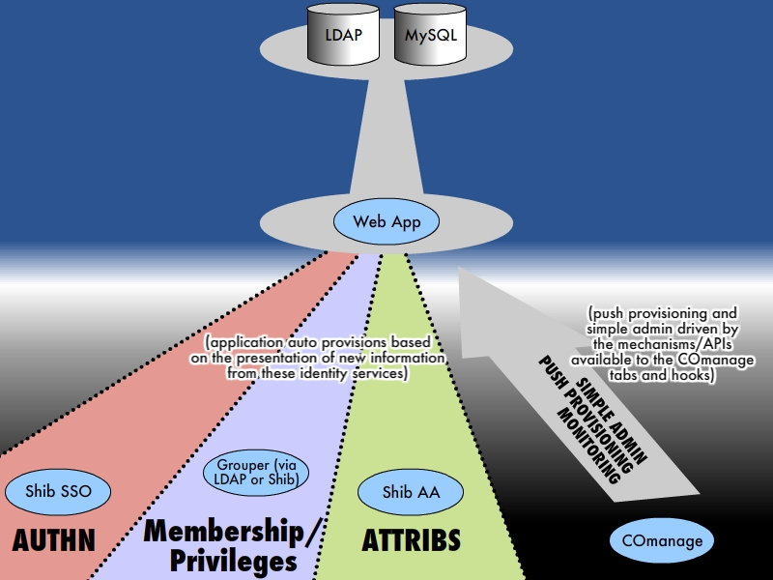

Slide 5
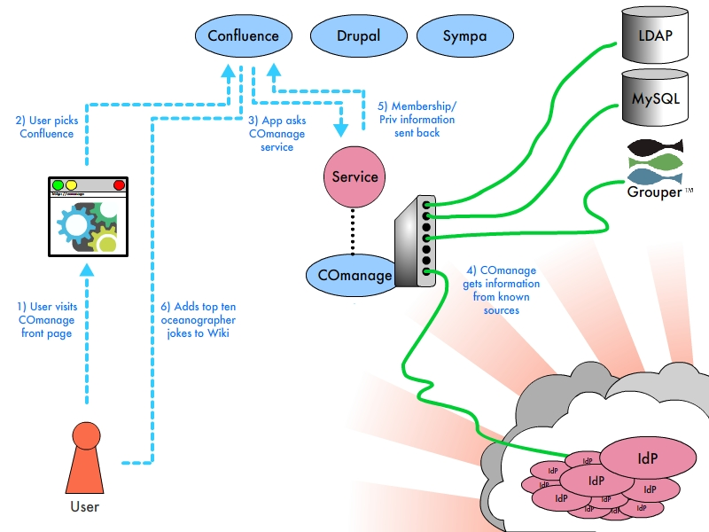

Slide 6

YOU HAVE NO QUESTIONS!
YOU LOVE COMANAGE.

Slide 7
Any Questions?

